Slide 1
Overview of Mass Storage Structure
Disk drive attached to computer by a set of wires called I/O bus
Busses vary, including EIDE, ATA, SATA, USB, Fiber Channel, SCSI, SAS, Firewire
Data transfers on bus carried out by special electronic processors called controllers
Host controller in computer uses bus to talk to disk controller built into drive or storage array

Slide 2
Overview of Mass Storage Structure
To perform a disk I/O operation
Computer places a command into the host controller, typically using memory-mapped I/O ports.
The host controller then sends the command via messages to the disk controller.
The disk controller operates the disk-drive hardware to carry out the command.
Disk controllers usually have a built-in cache.
Data transfer at the disk drive happens between the cache and the disk surface.
Data transfer to the host, at fast electronic speeds, occurs between the cache and the host controller.

Slide 3
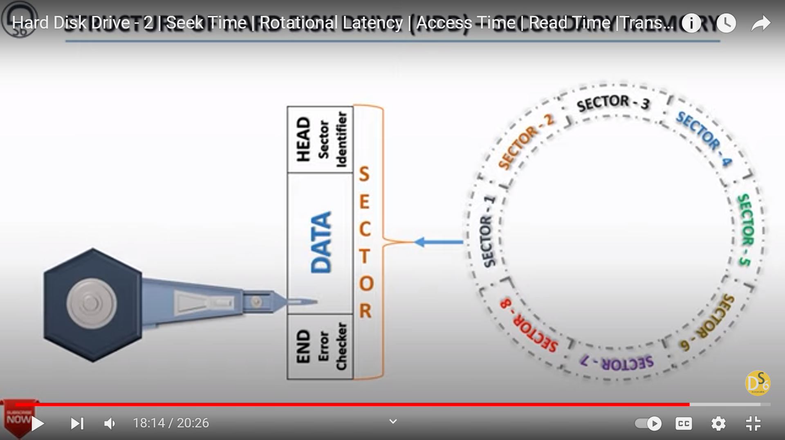

Slide 4
Hard Disk Performance
Access Latency = Average access time = average seek time + average latency
For fastest disk 3ms + 2ms = 5ms
For slow disk 9ms + 5.56ms = 14.56ms
Average I/O time = average access time + (amount to transfer / transfer rate) + controller overhead
For example, to transfer a 4KB block on a 7200 RPM disk with a 5ms average seek time, 1Gb/sec transfer rate with a .1ms controller overhead =
5ms + 4.17ms + 0.1ms + Transfer time
Transfer time = 4KB / 1Gb/s * 8Gb / GB * 1GB / 1024²KB = 32 / (1024²) = 0.031ms
Average I/O time for 4KB block = 9.27ms + .031ms = 9.301ms

Slide 5
Solid-State Disks (SSDs)
Nonvolatile memory used like a hard drive
Many technology variations
from DRAM with a battery to allow it to maintain its state in a power failure through flash-memory technologies like single-level cell (SLC) and multilevel cell (MLC) chips.
Can be more reliable than HDDs in certain situations
no moving parts → not sensitive to vibrations/movements.
Much faster
No moving parts → no seek time or rotational latency
Consume less power → Suitable for laptops, mobile devices, etc
More expensive per MB
Maybe have shorter life span
Less capacity
Busses can be too slow -> connect directly to PCI for example

Slide 6
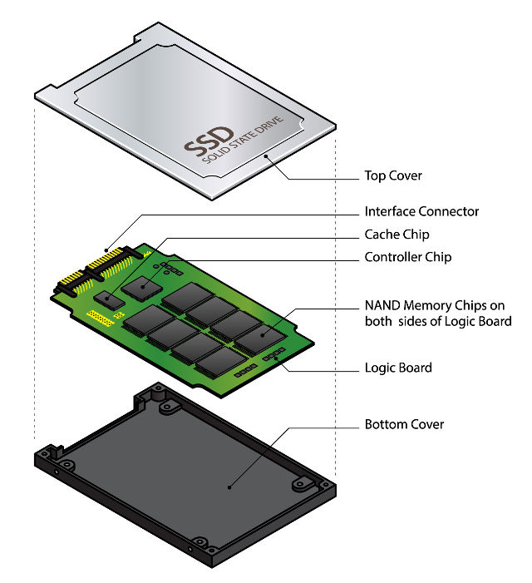
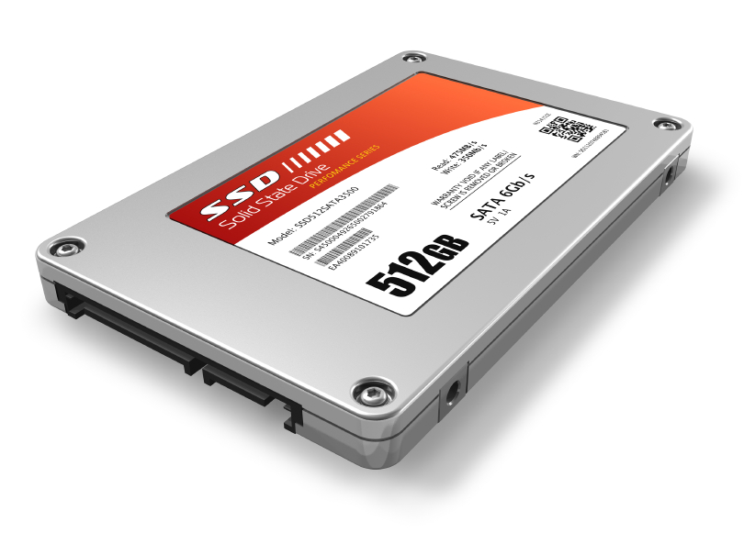
Solid-State Disks (SSDs)

Slide 7
Disk Structure
Disk drives are addressed as large 1-dimensional arrays of logical blocks, where the logical block is the smallest unit of transfer
Low-level formatting creates logical blocks on physical media
The 1-dimensional array of logical blocks is mapped into the sectors of the disk sequentially
Sector 0 is the first sector of the first track on the outermost cylinder
Mapping proceeds in order through that track, then the rest of the tracks in that cylinder, and then through the rest of the cylinders from outermost to innermost
By using this mapping,
In theory, can convert a logical block number into a disk address that consists of a cylinder number, a track number within that cylinder, and a sector number within that track.
In practice, difficult to perform this translation, for following reasons:
Most disks have some defective sectors, but the mapping hides this by substituting spare sectors from elsewhere on the disk.
Number of sectors per track is not a constant on some drives.

Slide 8
Disk Structure
Why number of sectors per track is not constant?
On media that use constant linear velocity (CLV), the density of bits per track is uniform.
The farther a track is from the center of the disk, the greater its length, so the more sectors it can hold.
As we go from outer zones to inner zones, number of sectors per track decreases.
The drive increases its rotation speed as head moves from outer to inner tracks to keep the same rate of data moving under head.
Alternatively, the disk rotation speed can stay constant.
In this case, the density of bits decreases from inner tracks to outer tracks to keep the data rate constant.
This method is used in hard disks and is known as constant angular velocity (CAV).

Slide 9
Disk Attachment
Computers access disk storage in two ways.
One way is via I/O ports (or host-attached storage)
common on small systems.
The other way is via a remote host in a distributed file system
referred to as network-attached storage.

Slide 10
Host-Attached storage
Host-attached storage is accessed through local I/O ports.
These ports use several technologies.
Typical desktop PC uses an I/O bus architecture called IDE or ATA.
supports a maximum of two drives per I/O bus.
A newer, similar protocol that has simplified cabling is SATA.
High-end workstations and servers generally use more sophisticated I/O architectures such as fiber channel (FC)
a high-speed serial architecture that can operate over optical fiber or over a four-conductor copper cable. It has two variants.
a large switched fabric having a 24-bit address space. This variant is expected to dominate in the future
an arbitrated loop (FC-AL) that can address 126 devices.
A wide variety of storage devices are suitable for use as host-attached storage. E.g., hard disk drives, RAID arrays, CD, DVD, and tape drives.
I/O commands that transfer data to a host-attached storage device are reads/writes of logical data blocks directed to specifically identified storage units (such as bus ID or target logical unit).

Slide 11
Network-Attached storage
A network-attached storage (NAS) device is a special-purpose storage system that is accessed remotely over a data network.
Clients access NAS via a remote-procedure-call interface such as NFS for UNIX systems or CIFS for Windows machines.
The remote procedure calls (RPCs) are carried via TCP or UDP over an IP network—usually the same LAN that carries all data traffic to clients.
Can think of NAS as simply another storage-access protocol.
The NAS unit is usually implemented as a RAID array with software that implements the RPC interface.
NAS provides a convenient way for all computers on a LAN to share a pool of storage with the same ease of naming and access enjoyed with local host-attached storage.
However, it tends to be less efficient and have lower performance than some host-attached storage options.

Slide 12
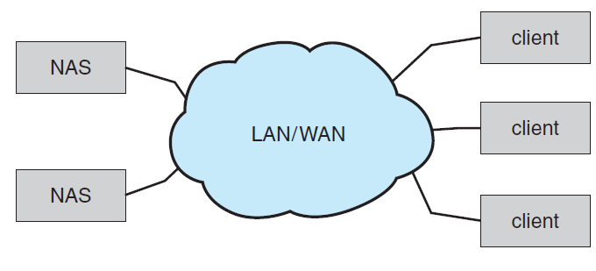
Network-Attached storage

Slide 13
Storage-Area Network
Storage-Area Network (SAN)
Common in large storage environments
Multiple hosts attached to multiple storage arrays - flexible

Slide 14
Storage Area Network
Drawback of NAS systems: storage I/O operations consume bandwidth on the data network → increasing latency of network communication.
This problem is severe in large client–server installations
the communication between servers and clients competes for bandwidth with the communication among servers and storage devices.
SAN is a private network (using storage protocols rather than networking protocols) connecting servers and storage units.
Power of a SAN lies in its flexibility.
Multiple hosts and multiple storage arrays can attach to the same SAN, and storage can be dynamically allocated to hosts.
A SAN switch allows or prohibits access between the hosts and the storage.
As one example, if a host is running low on disk space, the SAN can be configured to allocate more storage to that host.
SANs make it possible for clusters of servers to share the same storage and for storage arrays to include multiple direct host connections.

Slide 15
Disk Scheduling
OS is responsible for using hardware efficiently — for the disk drives, this means having a fast access time and disk bandwidth
Minimize seek time
Seek time ≈ seek distance
Disk bandwidth is the total number of bytes transferred, divided by the total time between the first request for service and the completion of the last transfer

Slide 16
Disk Scheduling (Cont.)
There are many sources of disk I/O request
OS
System processes
Users processes
I/O request includes input or output mode, disk address, memory address, number of sectors to transfer
OS maintains queue of requests, per disk or device
Idle disk can immediately work on I/O request, busy disk means work must queue
Optimization algorithms only make sense when a queue exists

Slide 17
Disk Scheduling (Cont.)
Note that drive controllers have small buffers and can manage a queue of I/O requests (of varying “depth”)
Several algorithms exist to schedule the servicing of disk I/O requests
The analysis is true for one or many platters
We illustrate scheduling algorithms with a request queue (0-199)
98, 183, 37, 122, 14, 124, 65, 67
Head pointer 53

Slide 18
First-Come, First-Served (FCFS)
Intrinsically fair
Generally does not provide the fastest service.

Slide 19
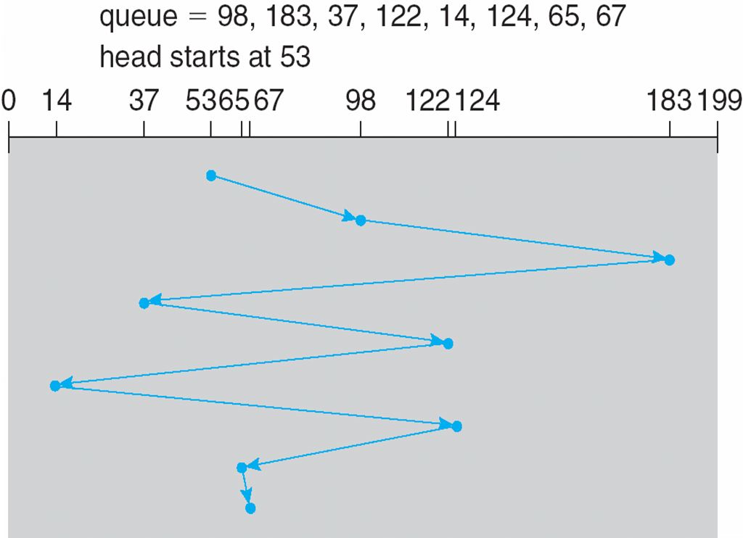
First-Come, First-Served (FCFS)
Illustration shows total head movement of 640 cylinders
Wild swing from 122 to 14 and then back to 124 illustrates the problem.
If 37 and 14 could be serviced together, before or after the requests for 122 and 124, performance can be improved.

Slide 20
Shortest-Seek-Time-First (SSTF)
Seems reasonable to service all requests close to current head position before moving the head far away to service other requests.
This assumption is the basis for SSTF algorithm.
Selects the request with the least seek time from the current head position.
In other words, SSTF chooses the pending request closest to the current head position.

Slide 21
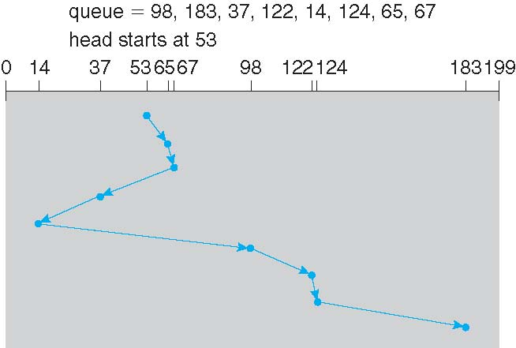
Shortest-Seek-Time-First (SSTF)
Closest request to initial head position (53) is at cylinder 65. Then the next closest request is at cylinder 67 and so on.
Results in total head movement of only 236 cylinders
little more than one-third of the distance needed for FCFS
gives a substantial improvement in performance.
May cause starvation of some requests: A continual stream of requests near one another could cause the request for a particular cylinder to wait indefinitely.
This scenario becomes increasingly likely as the pending-request queue grows longer.

Slide 22
SCAN
Disk arm starts at one end of disk, and moves toward other end, servicing requests until it gets to the other end of the disk, where the head movement is reversed and servicing continues.
The head continuously scans back and forth across the disk.
SCAN algorithm Sometimes called the elevator algorithm
Illustration shows total head movement of 208 cylinders
But note that if requests are uniformly dense, largest density at other end of disk and those wait the longest

Slide 23
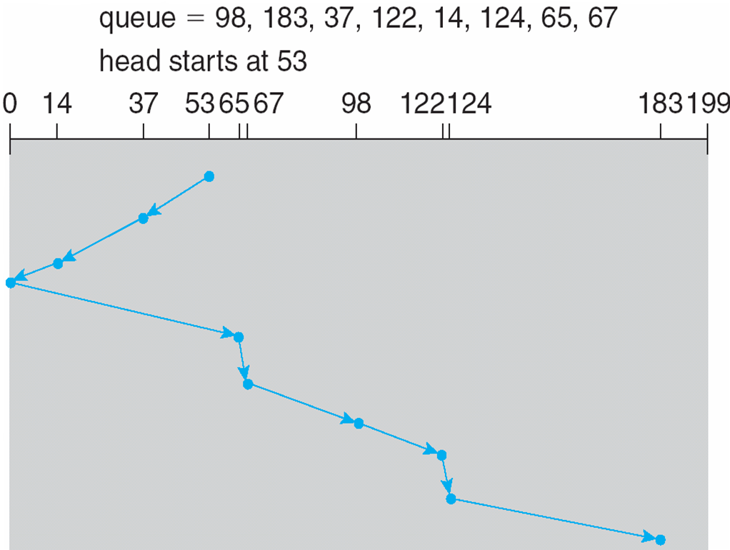
SCAN (Cont.)

Slide 24
Circular SCAN (C-SCAN)
Provides a more uniform wait time than SCAN
The head moves from one end of the disk to the other, servicing requests as it goes
When it reaches the other end, however, it immediately returns to the beginning of the disk, without servicing any requests on the return trip
Treats the cylinders as a circular list that wraps around from the last cylinder to the first one

Slide 25
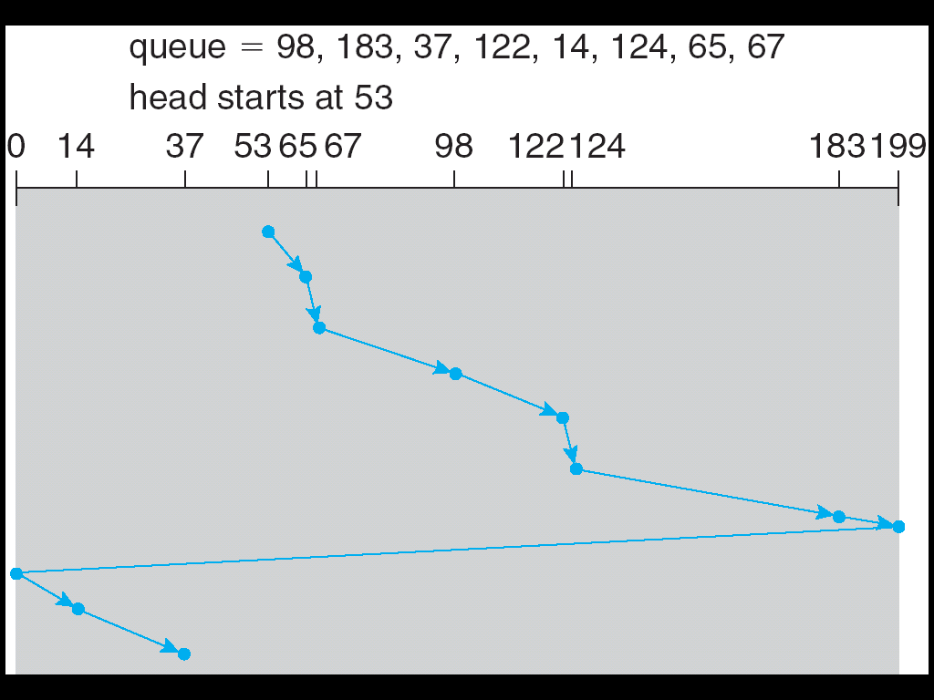
Circular SCAN (C-SCAN) (Cont.)

Slide 26
C-LOOK
Both SCAN and C-SCAN move the disk arm across full width of the disk.
In practice, neither algorithm is often implemented this way.
More commonly, the arm goes only as far as the final request in each direction.
Then, it reverses direction immediately, without going all the way to the end of the disk.
Versions of SCAN and C-SCAN that follow this pattern are called LOOK and C-LOOK scheduling, because they look for a request before continuing to move in a given direction.

Slide 27
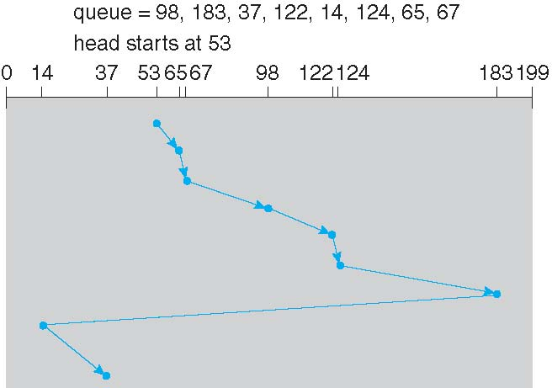
C-LOOK (Cont.)

Slide 28
Selecting a Disk-Scheduling Algorithm
SSTF is common and has a natural appeal
SCAN and C-SCAN perform better for systems that place a heavy load on the disk since SCAN and C-SCAN → less starvation
Performance depends on the number and types of requests
Requests for disk service can be influenced by the file-allocation method
A program reading a contiguously allocated file will generate several requests that are close together on the disk, resulting in limited head movement.
A linked or indexed file, in contrast, may include blocks that are widely scattered on the disk, resulting in greater head movement.
Due to high complexities and various factors involved, disk-scheduling algorithm should be written as a separate module of OS allows it to be replaced with a different algorithm if necessary.
Either SSTF or LOOK is a reasonable choice for the default algorithm
What about rotational latency? Difficult for OS to calculate.
I/O performance is not the only consideration; OS has its own priorities (e.g. paging). Therefore, cannot give the sole job of disk scheduling to disk hardware.

Slide 29
RAID Structure
Disk drives have continued to get smaller and cheaper, so it is now economically feasible to attach many disks to a computer system.
Having a large number of disks in a system presents opportunities for improving the rate at which data can be read or written, if the disks are operated in parallel.
Furthermore, this setup offers the potential for improving the reliability of data storage, because redundant information can be stored on multiple disks.
Thus, failure of one disk does not lead to loss of data.
A variety of disk-organization techniques, collectively called redundant arrays of independent disks (RAID), are commonly used to address the performance and reliability issues.
In the past, RAIDs composed of small, cheap disks were viewed as a cost-effective alternative to large, expensive disks.
Today, RAIDs are used for their higher reliability and higher data-transfer rate, rather than for economic reasons.

Slide 30
RAID: Improvement of Reliability via Redundancy
The chance that some disk out of a set of N disks will fail is much higher than the chance that a specific single disk will fail.
Suppose that the mean time to failure of a single disk is 100,000 hours.
Then the mean time to failure of some disk in an array of 100 disks will be 100,000/100 = 1,000 hours, or 41.66 days
This is not long at all!
If we store only one copy of the data, then each disk failure will result in loss of a significant amount of data—and such a high rate of data loss is unacceptable.
The solution to the problem of reliability is to introduce redundancy
we store extra information that is not normally needed but that can be used in the event of failure of a disk to rebuild lost information.
Thus, even if a disk fails, data are not lost.

Slide 31
RAID: Improvement of Reliability via Redundancy
The simplest (but most expensive) approach to introducing redundancy is to duplicate every disk. This technique is called mirroring.
With mirroring, a logical disk consists of two physical disks, and every write is carried out on both disks.
If one of the disks fails, data can be read from the other.
Data lost only if second disk fails before first failed disk is replaced.
The mean time to failure of a mirrored volume—where failure is the loss of data—depends on two factors.
The mean time to failure of the individual disks.
The mean time to repair, which is the time it takes (on average) to replace a failed disk and to restore the data on it.

Slide 32
RAID: Improvement in Performance via Parallelism
With disk mirroring:
rate at which read requests handled is doubled, since read requests can be sent to either disk.
transfer rate of each read is the same as in a single-disk system, but the number of reads per unit time has doubled.
With multiple N disks striping:
can improve transfer rate by striping data across the disks.
data striping consists of splitting the bits of each byte across multiple disks; such striping is called bit-level striping.
Every disk participates in every access (read or write)
The number of accesses that can be processed per second is about the same as on a single disk, but each access can read N times as many data in the same time as on a single disk.
Striping need not occur at the bit level. In block-level striping, blocks of a file are striped across multiple disks.

Slide 33
RAID Levels
Mirroring provides high reliability, but it is expensive.
Striping provides high data-transfer rates, but it does not improve reliability.
Numerous schemes to provide redundancy at lower cost by using disk striping combined with “parity” have been proposed.
These schemes have different cost–performance trade-offs and are classified according to levels called RAID levels.
Most common RAID levels are:
RAID 0: “disk striping”
RAID 1: “disk mirroring”
RAID 5
RAID 10

Slide 34
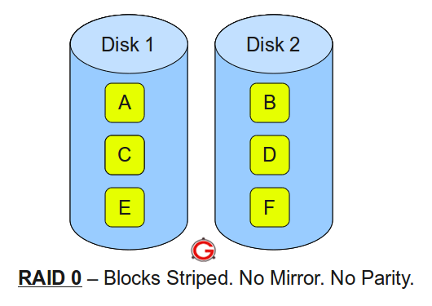
RAID Level 0: “striping”
Minimum 2 disks.
Excellent performance ( as blocks are striped ).
No redundancy ( no mirror, no parity ).
Don’t use this for any critical system.

Slide 35
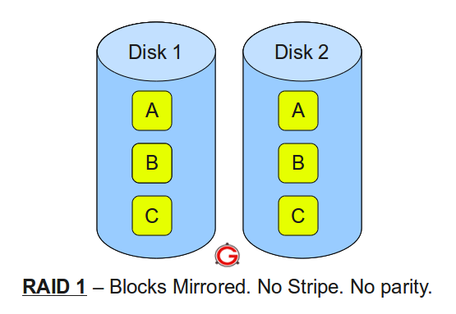
RAID Level 1: “mirroring”
Minimum 2 disks.
Good performance ( no striping. no parity ).
Excellent redundancy ( as blocks are mirrored ).

Slide 36
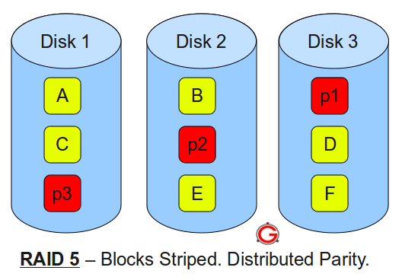
RAID Level 5
Minimum 3 disks.
Good performance ( as blocks are striped ).
Good redundancy ( distributed parity ).
Best cost effective option providing both performance and redundancy.
Use this for data that is heavily read oriented. Write operations will be slow.

Slide 37
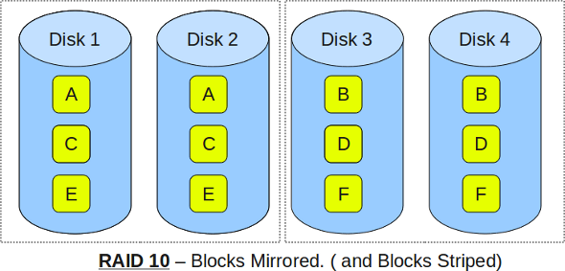
RAID Level 10
Minimum 4 disks.
This is also called as “stripe of mirrors”
Excellent redundancy ( as blocks are mirrored )
Excellent performance ( as blocks are striped )
Very costly.
If you can afford the dollar, this is the BEST option for any mission critical applications.

